Slide 1
Network Overview & Layers

Slide 2
Outline
Interesting properties of network
Layers of network
  The link layer
  The network layer
  The end-to-end layer
Congestion control
Today: 7.1-7.2
Notes:
Message passing VS. Shared memory

Slide 3
Network overview
Basic abstraction
  Communication link: SEND & RECEIVE
Design considerations
  (1) a trio of fundamental physical properties,
  (2) the mechanics of sharing, and
  (3) a remarkably wide range of parameter values
Notes:
Interesting properties
Interface style
Interface timing
Latency
Failure modes
Parameter ranges

Slide 4
Consideration 1 of 3: Physical properties
Propagation delay
  The speed of light is finite
  Accommodate a range of delay spanning 7 orders of magnitude, 224 mili seconds --10nano sec: the first parameter
Hostile environment
  A burst noise, a careless backhoe operator, etc.
Limited bandwidth
  Limited signaling, finite signal power, noise
  The second parameter: available data rate

Slide 5
Consideration 2 of 3: Sharing of facilities
Any-to-any connection
  Number of separated paths grows with the square
  The third parameter: number of connected entities
Sharing of communication costs
  Same tech trends as processor, memory, etc.
  Digging up streets to lay wire or fiber, satellite, etc.
  Communication costs rarely fall as fast as tech would permit

Slide 6
Consideration 3 of 3: Four different parameters
Propagation times: latency
Data rates: throughput
Number of communicating computers: scale
Different network loads
  Ranging from 30MB/s to 1 B/s
----------------- （ System that use network as a component must take them into account ）

Slide 7
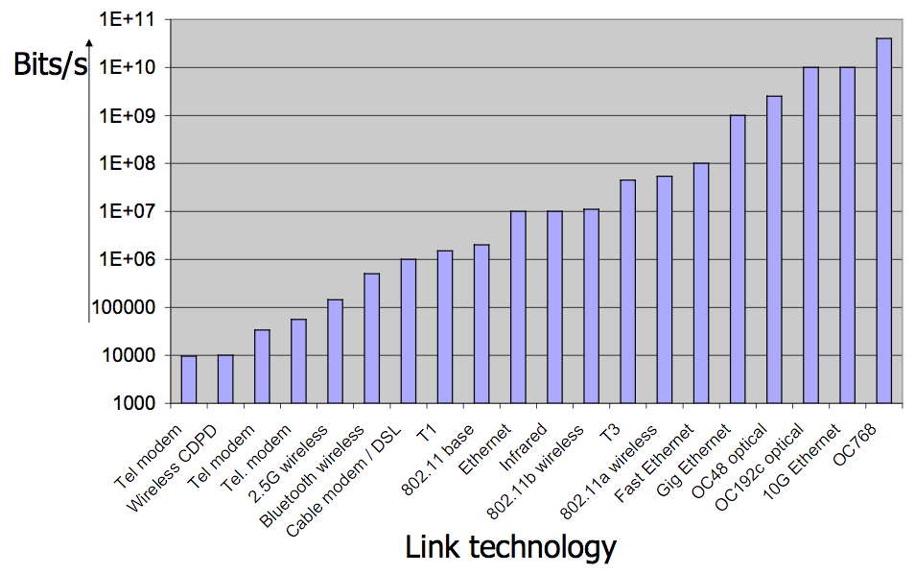
Networks are heterogeneous

Slide 8
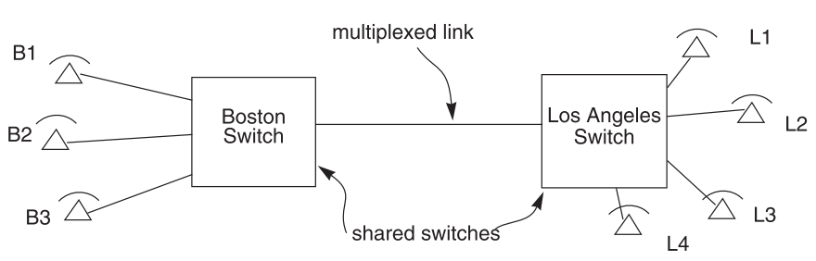
Isochronous multiplexing
Telephone network
  “network is busy”

Slide 9
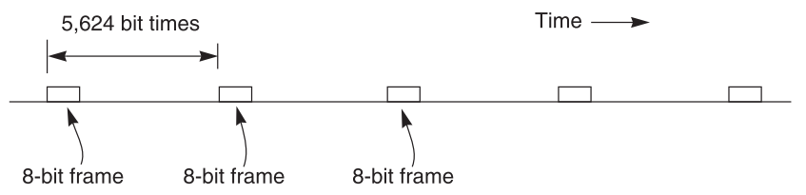
Isochronous - TDM
64 Kbps each phone, 45 Mbps link
8-bit block (frame), 8000 frames per second
5625 bit times or 125 us
703 simultaneous conversations
Why the voice is still continuous, instead of fragmented?

Slide 10
Connection vs. connectionless
Isochronous communication
  Needs prior arrangement between switches
Connection: an agreement that this periodic series of frames should be sent along to L3
    set up , tear down,record state
  Stream: continuous bits flows out of a phone
Data communication
  Message: burst data, ill-suited to fixed size and spacing of isochronous frames
  Connectionless, asychronous

Slide 11
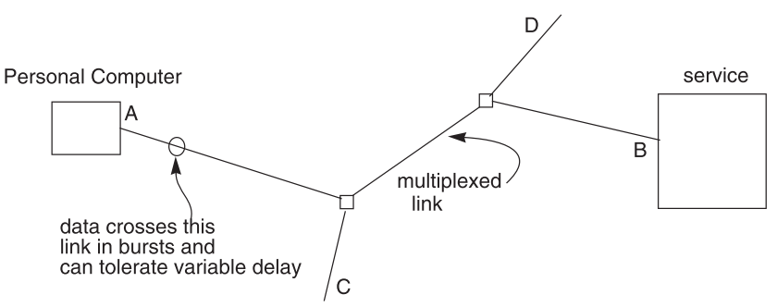
Data communication network

Slide 12
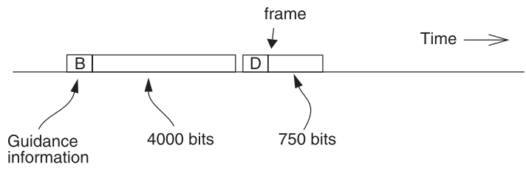
Frame and packet
Asynchronous link
  Frame can be of any length, carried at any time that the link is free
  Packet: a variable-length frame with its guidance info
  Connectionless transmission: no state maintained
  reassemble
  Packet voice: replacing many part of isochronous network
Notes:
Segment and reassemble

Slide 13
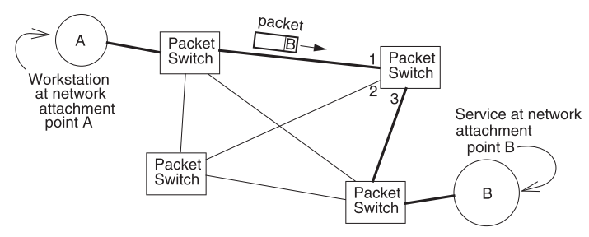
Packet forwarding
Packet switching
  Routing: choosing a particular path (control plane)
  Forwarding: choosing an outgoing link (data plane)
    Usually by table lookup

Slide 14
Delay (transit time)
Propagation delay
  Depends on the speed of light in the transmission medium
Transmission delay
  Depends on the data rate of the link and length of the frame
  Each time the packet is transmitted over a link
Processing delay
  E.g. examine the guidance info, checksum, etc.
  And copying to/from memory
Queuing delay
  Waiting in buffer
  Depends on the amount of other traffic

Slide 15
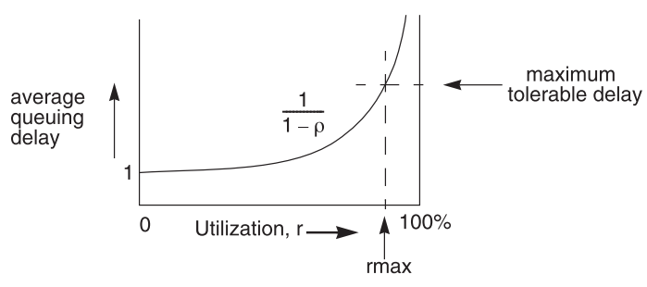
Queuing theory
ρ: utilization of the outgoing line, from 0 to 1

Slide 16
Queuing theory
Tradeoff ： between delay and utilization
  Delay rises rapidly as the line utilization approaches 100%
  Average delay vs. peak delay
limit the size of queues, exerting control on arrival
  Shift delays to other places in the network

Slide 17
Buffer overflow
Queuing theory’s implication
  Buffer space is needed to hold the waiting packets
  How large a buffer should the designer allocate?
  The average number is 1/(1-ρ)
  The variance of queue length is also 1/(1-ρ)
  How to handle peaks? Bursting batches?

Slide 18
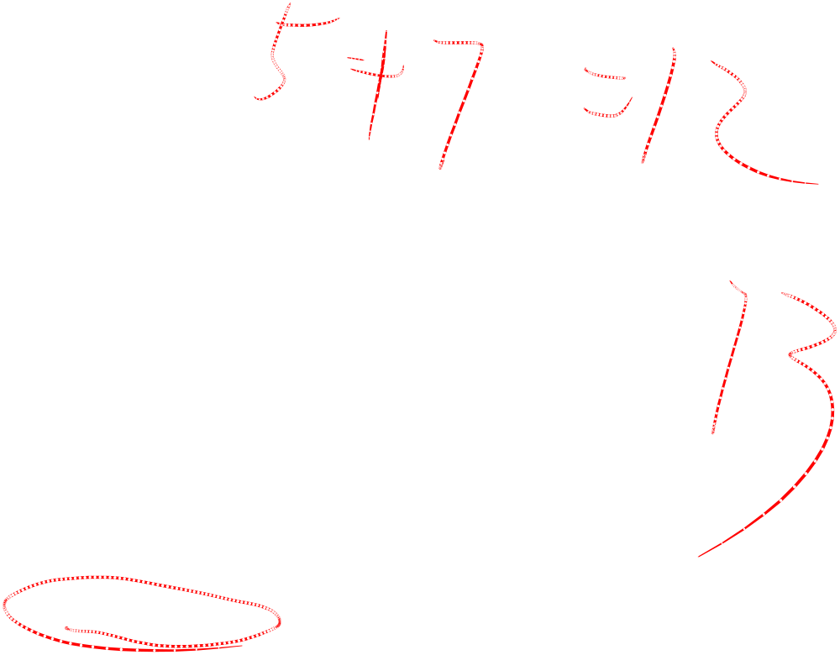
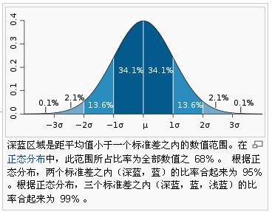

Slide 19
Choosing a buffer size
Plan for the worst case
  Allocate enough buffer to handle the worst case
Plan for the usual case and fight back
  Allocate buffer that work most of the time
  If buffer is full, send message back and ask someone to stop sending
Plan for the usual case ， discard overflow
  Allocate buffer that work most of the time
  If buffer is full, ruthlessly discard packets

Slide 20
Not for worst case
Even memory is cheap，
we don’t allocate a buffer for the worst case
Worst case may be many orders of magnitude larger than average case
Even one node has enough buffer, other node may quit instead of waiting
Then, how about buffer overflow ?

Slide 21
Push back vs. discard
Push back
  Send a message back along the incoming link
  “Don’t send any more until you hear from me”
  The message itself may add the congestion
  Which source to stop? It may be no longer sending
Throw away
  The source will resend
  Automatic rate adaptation
    Sender interprets the lack of ACK as congestion
    Reduce the sending rate

Slide 22
Best-effort network
Best-effort network
  If it cannot dispatch, it may discard a packet
Guaranteed-delivery network
  store-and-forward network, no discarding data
  Work with complete messages rather than packets
  Uses disk for buffering to handle peaks
  Tracks individual message to make sure none are lost
In real world
  Guaranteed-delivery : higher layer ……..
  best-effort : lower layer
Notes:
In real world
no absolute Guaranteed-delivery

Slide 23
Duplicate packets and suppression
Discarding packets is common case
  Many network protocol includes timeout and resend mechanism
When a congested forwarder discards a packet
  Client doesn’t receive a response as quickly as originally hoped
  Users may prepared for duplicate requests and responses
    Detecting duplicates may or may not be important

Slide 24
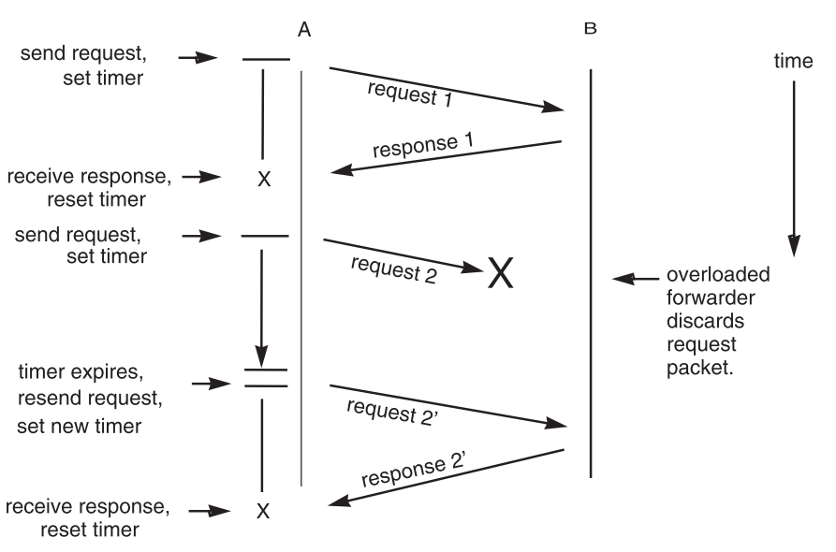

Slide 25
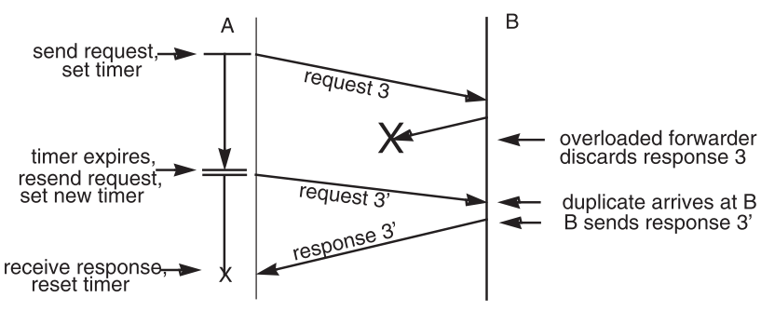
Duplicate packets and suppression

Slide 26
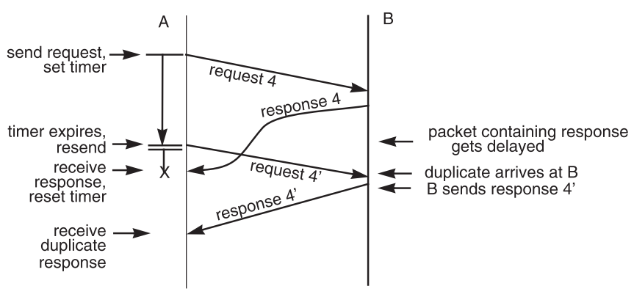
Duplicate packets and suppression

Slide 27
Duplicate packets and suppression
Request and response number
  Each request includes a nonce
  Nonce: a unique ID that never be reused by A
B maintains a list of nonce
  Check the list to detect duplicates
  Not do it again, but response aganin
Idempotent design
  Repeating the same request has the same effect as doing it just once

Slide 28
Damaged packets and broken links
Data can be damaged
  Noise, during transit, in memory
  Error detection and correction are needed
    Checksum: redundant error-detecting info (k-bit)
    Parity check: when k=1
  What about just discard the damaged packets?
    Discarding problem is solved
More details in Chap-8

Slide 29
Reordered delivery
  A sends ——→ B, B gets Different order of packets
  Because More than one path from A to B
  Need further info to reorder ①
M2 M1
Notes:
① Just like your friend send you several postcards with 1 story, and you have to wait and find the correct sequence

Slide 30
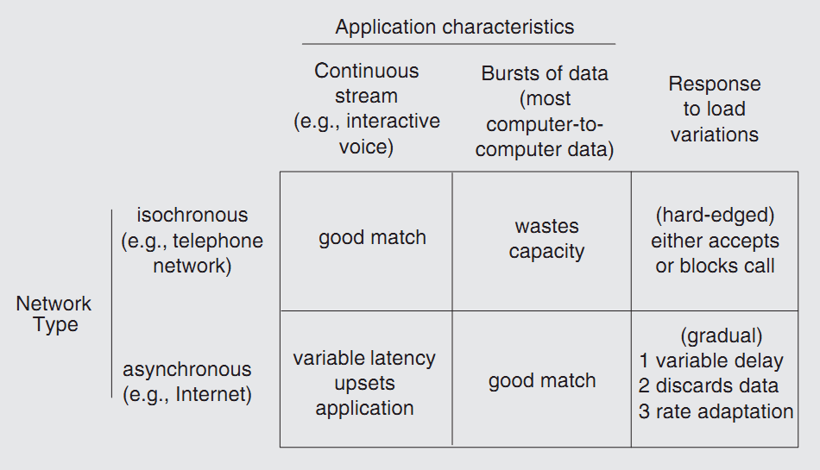
Summary & the best-effort contract

Slide 31
Summary & the best-effort contract
1. Networks encounter a vast range of parameters
  Data rates
  Propagation, transmission, queuing, and processing delays.
  Loads
  Numbers of users
2. Networks traverse hostile environments
  Noise damages data
  Links stop working
3. Best-effort networks have
  Variable delays
  Variable transmission rates
  Discarded packets
  Duplicate packets
  Maximum packet length
  Reordered delivery

Slide 32
Layers in network
layering
  Adopt sweeping simplifications
  Divide-and-conquer
  Layering of protocols
    What is a protocol?

Slide 33
An example: FIRE in a video game
FIRE in a video game
  FIRE ( #_of_missiles, target, action_if_defended )
  procedure FIRE ( n_missiles, where, reaction )
Interpreted at two levels (implicit agreement)
  The system matches the name FIRE with the procedure and transfer control to it
  The procedure matches the arguments, position by position

Slide 34
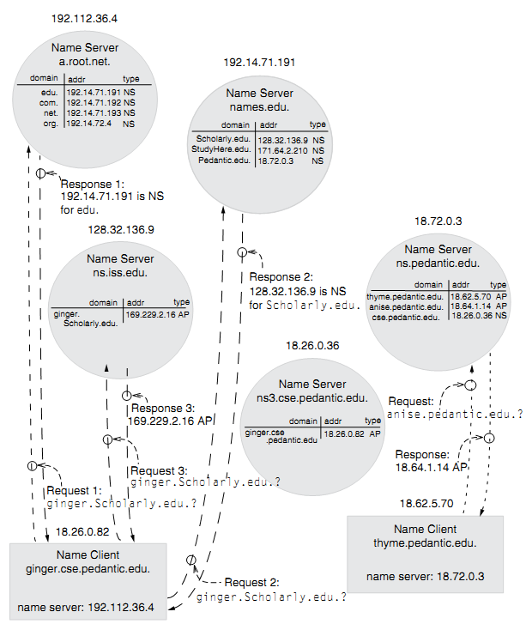
Specifications and protocols
Specification (in programming language)
  A set of agreements (contract) on how to interpret both the order and the meaning of arguments
Protocol (in networks)
  More than interpretation of the arguments
  Encompass everything that either of the two parties can depend on about how the other will act or react

Slide 35
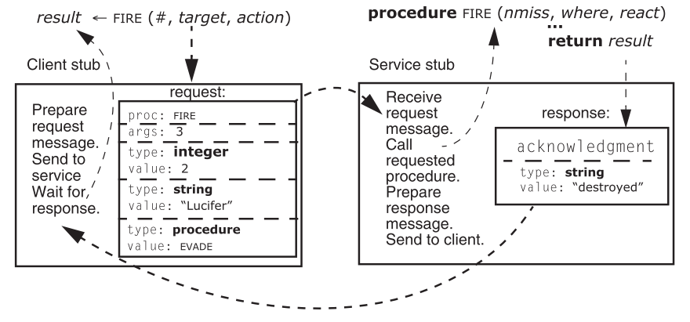
Protocol example ： RPC version
*
*
*
*
*
*

Slide 36
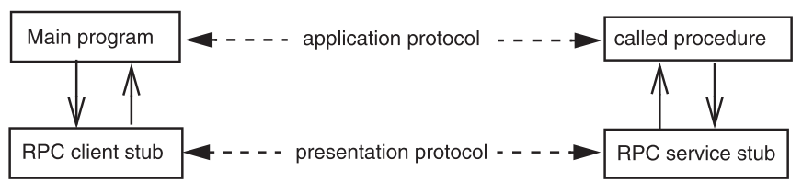
Two protocol layers
Presentation protocol between two stubs
  The name of the procedure
  The number of arguments
  The types of each argument

Slide 37
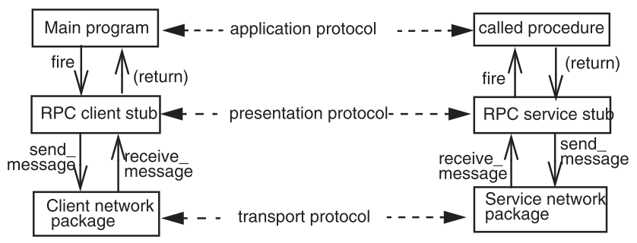
Three protocol layers
Transport protocol
  SEND_MESSAGE (request_message, service_name)
  Each module has not two, but three interfaces
3rd interface

Slide 38
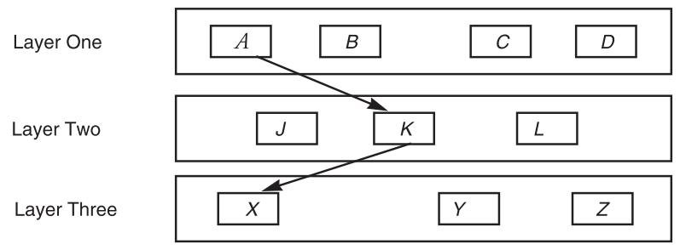
Layered design
Each layer hides the operation of the layer below , from the layer above
Provides its own interpretation of all the features of the lower layer
A may call J, K, L
A CAN’T see X,Y,Z

Slide 39
Layers in network
Application
  Can be thought of as a fourth layer
  Not part of the network
End-to-end layer
  Everything else required to provide a comfortable application interface
Network layer
  Forwarding data through intermediate points to move it to the place it is wanted
Link layer
  Moving data directly from one point to another

Slide 40
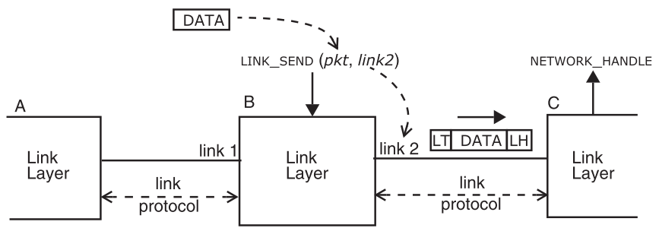
Link layer
LINK_SEND ( data_buffer, link_identifier )

Slide 41
Link layer
Manage low-level communication
Goal: move the bits of the packet across one link
Hiding from the upper layer : the particular mechanics of data transmission that are involved
Encode/fragment/resend the data

Slide 42
Link layer
Payload: the data passed from an upper layer to a lower layer
Header and trailer
Upcall: when data arrives, the lower layer makes a procedure call up in the higher layer
  NETWORK_HANDLE

Slide 43
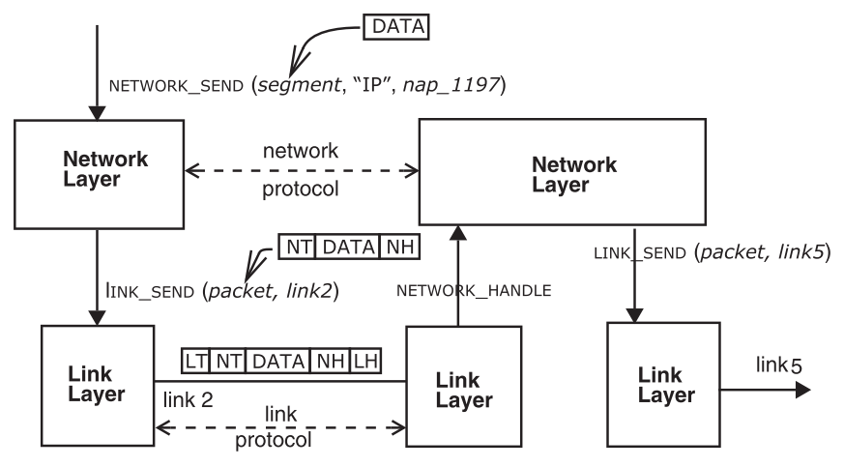

Network layer
How does Network Layer select a link?
NETWORK_SEND (segment_buffer, network_identifier, destination)

Slide 44
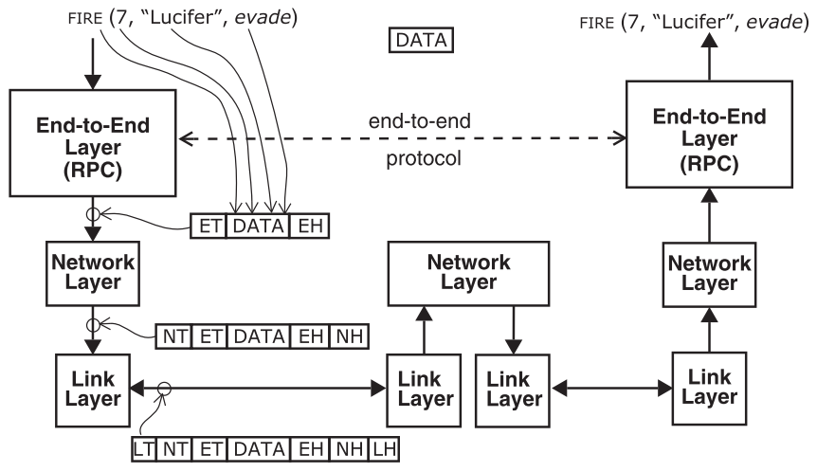
End-to-end layer

Slide 45
End-to-end layer
Provide several distinct end-to-end services
  Presentation services: translating data formats, and emulating the semantics of a procedure call
  Transport services: dividing into segments and dealing with lost, duplicated, out-of-order
  Session services: e.g. contains an ID to tell the service which client is making this call
Lower layer will not look inside the payload

Slide 46
Layers in OSI, TCP/IP & CSE
7th Application Layer
Application Layer
End-to-End Layer
6th Presentation Layer
5th Session Layer
4th Transport Layer
Transport Layer
3th Network Layer
Network Layer
Network Layer
2nd Link Layer
Link Layer
Link Layer
1st Physical Layer
OSI
TCP/IP
CSE

Slide 47
Layers in OSI, TCP/IP & CSE
End-to-End Layer
End-to-End Layer
End-to-End Layer
End-to-End Layer
Network Layer
Network Layer
Network Layer
Network Layer
Link Layer
Link Layer
Link Layer
Link Layer

Slide 48
End-to-end argument
Application knows best ()
  Stream to printer v.s. VOIP v.s. File downloading
  Don’t bury it in a lower layer, let the end points deal with it because they know best what they need
  Use library instead of layers, e.g. RPC
  Example: file transfer
    Checksum in end-to-end layer (md5)
    Checksum in link layer → resend only the damaged frame

Slide 49
Mapped applications
Mapped composition
  A network layer is built on another network layer
  Mapping higher-layer network addresses to lower-layer network address
    e.g. Appletalk maps its network layer to Ethernet
  Internetworking (Internet): links many different network layers together, mapping to IP network layer
    ARP/RARP: mapping Ethernet addr to and from IP addr
    Map wireless, satellite, cable TV, etc to IP addr .

Slide 50
Recursive applications
Recursive composition
  A network layer rests on a link layer that itself is a complete three-layer network
  e.g. A dial-up telephone line as an attachment point of the Internet, which goes through a telephone network
  An overlay network uses an existing network as links, e.g. Gnutella
  VoIP, voice telephone network on the Internet
  A tunnel, e.g. VPN

Slide 51
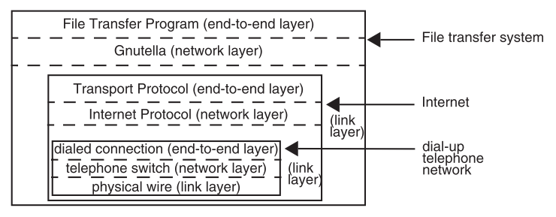
Recursive network composition
Gnutella is a large decentralized P2P network
The link layer itself is a network

